Slide 1
Case:
Exploratory Data Analysis in Online Casinos
Reveneu and Performance
Jean Paul Chong Shing C.
April 6th, 2025

Slide 2

Analyze online casino performance metrics
Connecticut Online Casino Consortium
Data Source: monthly license revenue reports

Slide 3

Methodology
Processing: Cleaning, date conversion, create metrics
Exploratory analysis: view revenue, licences, promotion.
Descriptive analysis: correlation and insights.
Business Recommendation

Slide 4

The Problems
Revenue Trends Analysis:
How has the total gaming revenue changed over time?
Are there seasonal trends in casino revenue?
Impact of Promotions:
Do promotional credits and deductions lead to higher overall revenue?
Is there a correlation between promotional spending and net winnings?
Casino Performance Comparison:
Which casino licenses generate the highest revenue?
Are there specific casinos consistently underperforming?
Wagering and Payout Patterns:
How do cancelled wagers impact revenue?
What percentage of wagers is typically returned as winnings?

Slide 5
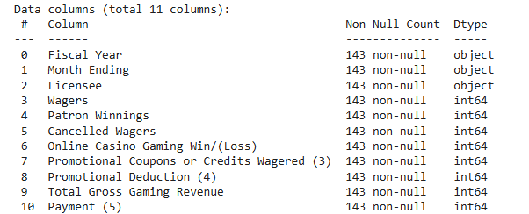
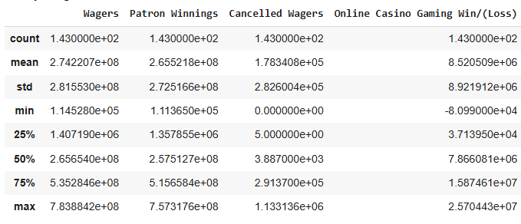
DATA SET DESCRIPTION
Consumidor
Artista
The dataset contains 143 records with 11 columns.
There are no null values, so imputation is not required.
The data ranges from October 2021 to 2024.

Slide 6

FASE: EDA
Exploratory Data Analysis

Slide 7
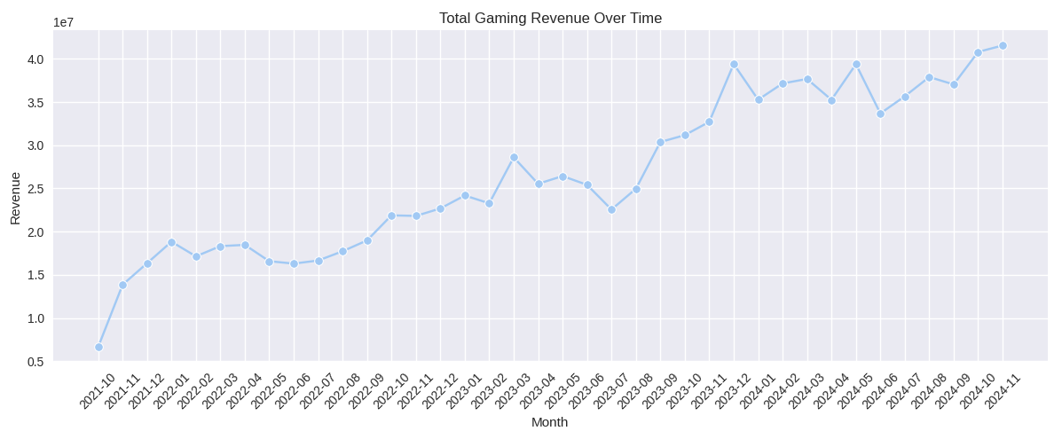
Q1. Revenue Trends Analysis
How has the total gaming revenue changed over time?
Are there seasonal trends in casino revenue?
+
The total revenue has shown increasing patterns from October 2021 onwards, an stability from Jan 2022 to Sep 2022, them increasing fluctuation almost of 200% of growing.
Peaks are observed in March, November, suggesting potential seasonality (holidays or promotions). People have more free time and are more willing to spend on entertainment such as online gaming.
Overall trend shows a overall upward trajectory, showing long-term market growth

Slide 8
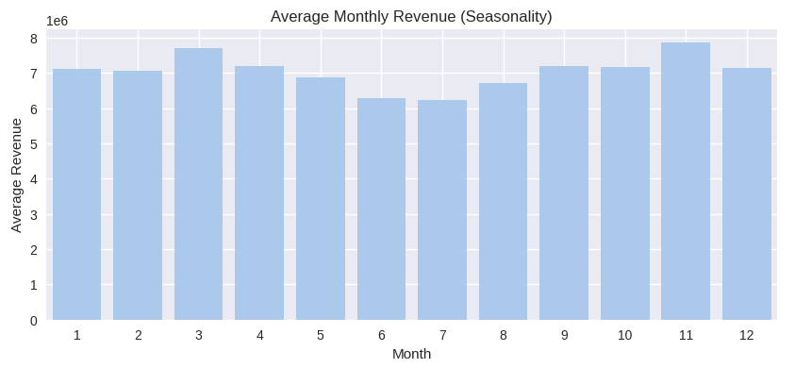
Seasonality Analysis (monthly)
There is a pattern indicating slightly higher revenues in months like March and November, suggesting a potential seasonal behavior.

Slide 9
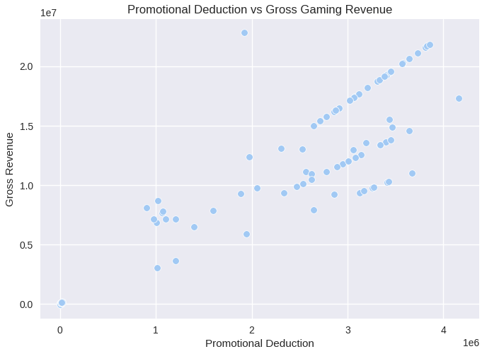

Q2: Impact of Promotions
Do promotional credits and deductions lead to higher overall revenue?
Yes, are evidence that promotional credits and deductions are positively associated with higher gross gaming revenue. Based on the correlation analysis:
Promotional Deductions have a very strong positive correlation (0.94) with Total Gross Gaming Revenue.
Promotional Credits Wagered have a moderate positive correlation (0.44) with gross revenue.
This suggests that when casinos invest more in promotions, they generally see higher revenues, likely because such promotions encourage more play and attract more users.

Slide 10
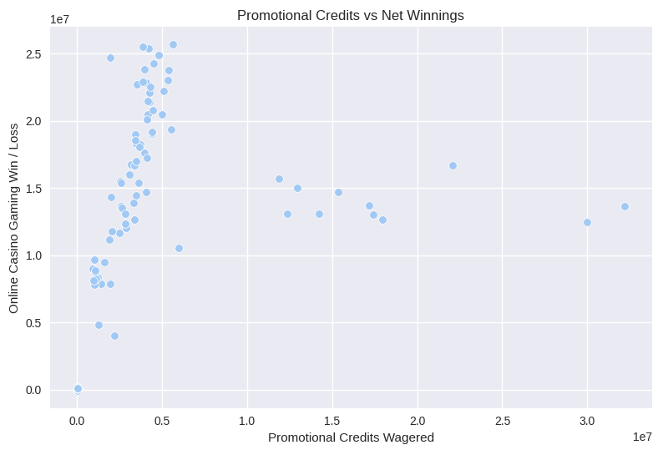
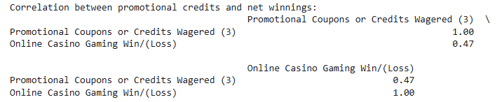
Q2: Impact of Promotions
2. Is there a correlation between promotional spending and net winnings?
There is a moderate positive correlation (0.47) between promotional credits wagered and net winnings.
This suggests that when players use promo credits, they tend to generate higher net profits for the casino.
Promotions not only attract more wagers but may also influence player behavior in ways that increase casino profitability.

Slide 11
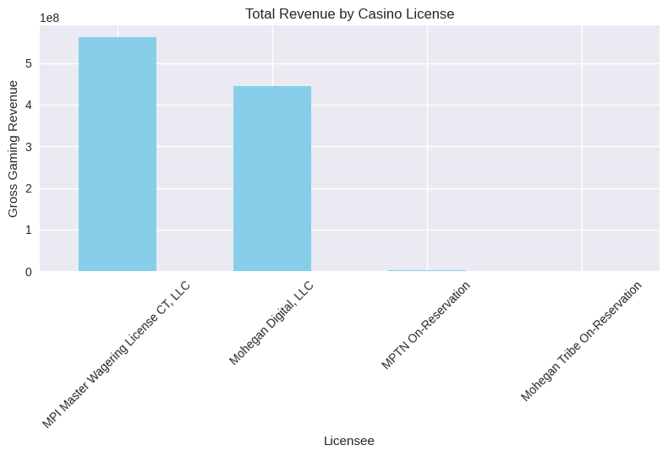
Q3: Casino Performance Comparison
5. Which casino licenses generate the highest revenue?
MPI Master Wagering License CT, LLC is the top-performing casino license with over $561 million in gross gaming revenue.
Mohegan Digital, LLC follows closely with $444 million.
The two on-reservation licenses (MPTN and Mohegan Tribe) have significantly lower revenue.

Slide 12
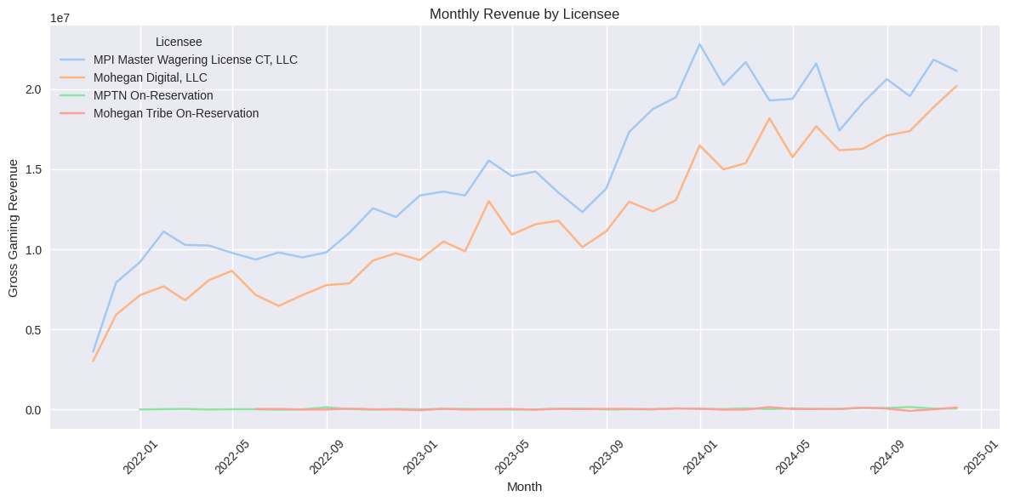
Q3: Casino Performance Comparison
6. Are there specific casinos consistently underperforming??
Yes. Based on the monthly revenue trends shown in the line chart:
MPTN On-Reservation and Mohegan Tribe On-Reservation show consistent underperformance over time.
Their revenue is significantly lower than MPI and Mohegan Digital, with no notable spikes or upward trend.

Slide 13
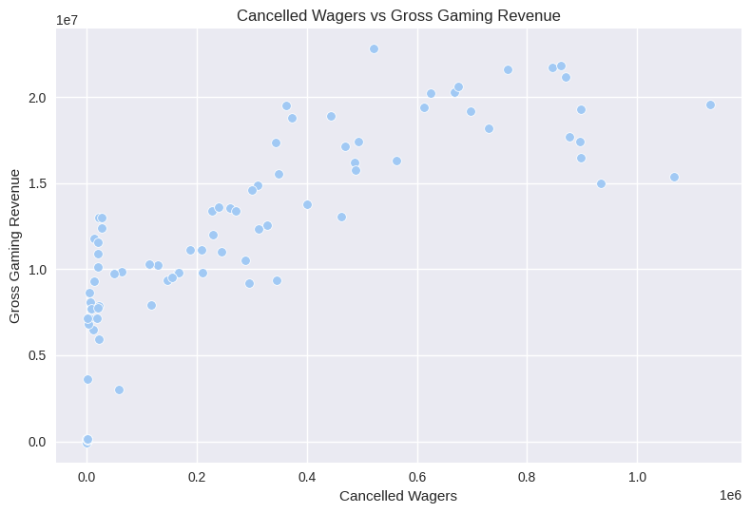

Q4: Wagering & Payout Patterns
7. How do cancelled wagers impact revenue?
Yes. strong positive correlation of 0.83 between Cancelled Wagers and Gross Gaming Revenue:
Cancelled wagers show a strong positive correlation with gross revenue.
This means that higher total revenue months tend to also have more cancelled wagers.
However, this does not mean cancellations increase revenue, but rather that they are more common when activity is higher overall.
In other words, cancelled wagers are not harmful, but a byproduct of increased wagering activity.

Slide 14
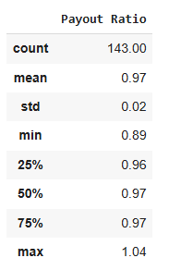
Q4: Wagering & Payout Patterns
8. What percentage of wagers is typically returned as winnings?
To respond this, i'm using data statistic:
The average payout ratio is 97.0%, meaning that for every $100 wagered, approximately $97 is returned to players as winnings.
The lowest payout observed was 89%, while the highest reached 104%, indicating that in rare cases, players won more than they wagered.
The standard deviation is 2%, showing low variability and suggesting that payout behavior is very consistent across months and licensees.

Slide 15
Extra: Business Recommendations
1. Invest Strategically in Promotions
Promotions are strongly linked to revenue growth.
Focus on optimizing promo campaigns by targeting peak gaming periods.
2. Monitor Revenue and Wagering Trends Monthly
Continue tracking performance using visual dashboards and correlation tracking.
Use data to detect early signals of decline or growth in specific licenses.
3. Maintain High Payout Standards
Keep the payout ratio near 95%–97% to maintain player trust and retention.
Investigate any months with payout ratios above 100% to ensure sustainability.

